Slide 1
design and implementation of a “njangi” application system
Members:
Chunke Blessing
Ousmanou Bouba
Ashu Brandon
Samme Samuel
Fuga Manguuue Francisco
Course instructor:
Eng. KAH KISSINGER

Slide 2
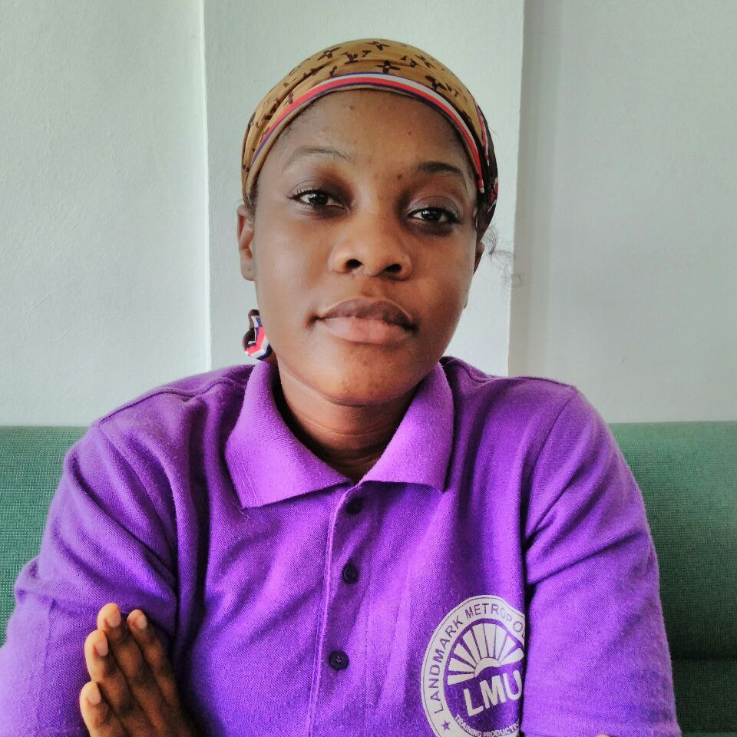
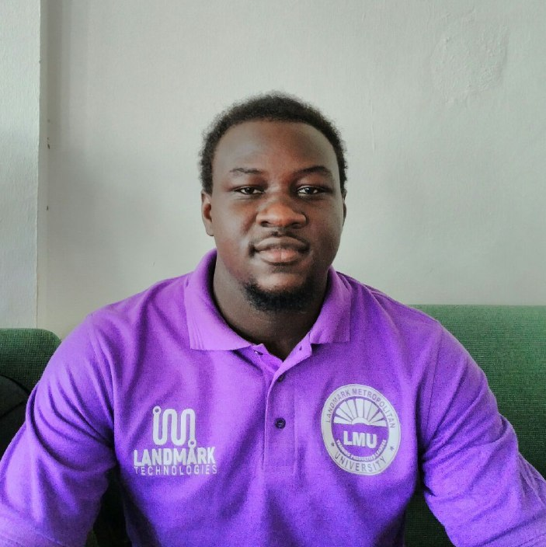
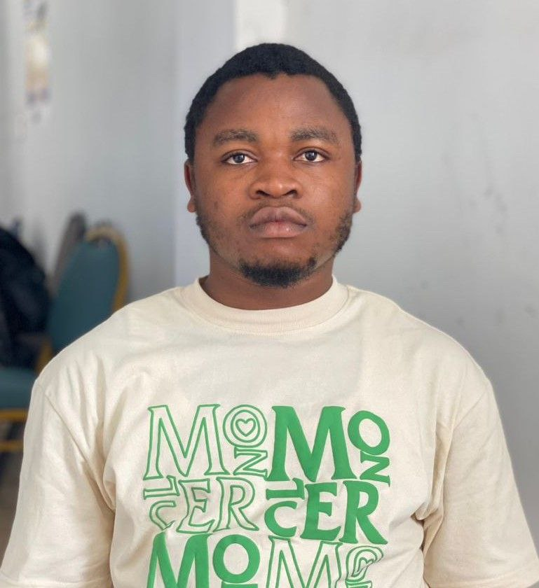
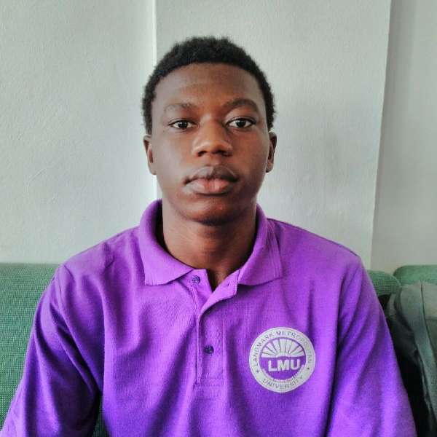
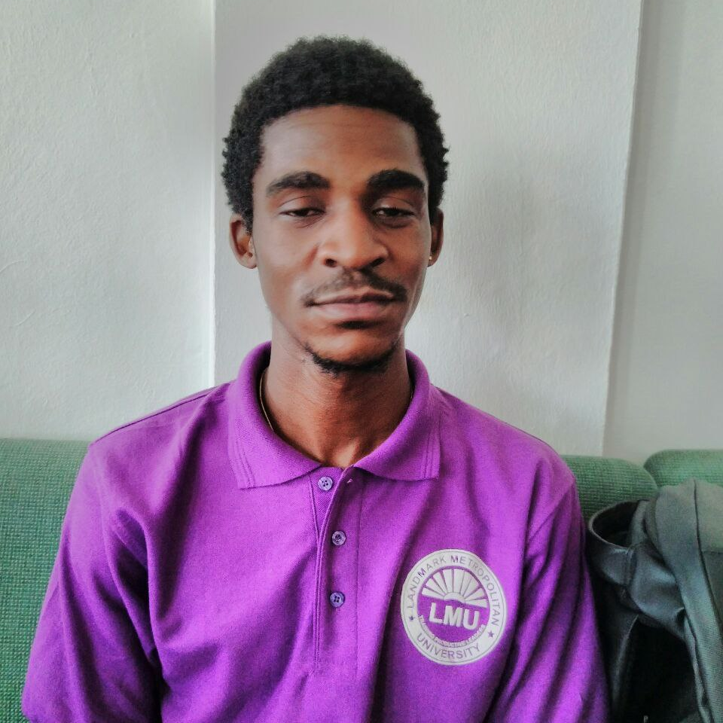
team
CHUNKE BLESSING
OUSMANOU BOUBA
Ashu brandon
SAMME SAMUEL
Research
Analysis Lead
Power point representation
UML diagrams
Documentation
Project Lifecycle
Figma representation
FUGA FRANCISCO

Slide 3
CONTENTS
Introduction
Objectives
Requirements
Project lifecycle
UML diagrams
Business Opportunities
Figma representation

Slide 4
INTRODUCTION
“NJANGI” is a contribution given to members in a rotating form at every sitting. In Addition, a “NJANGI” system helps members to carry out financial activities in a cultural and lovely manner with good relationships among members without having to pay for the services offered like what banks charges to it’s members .

Slide 5
objectives
The Objectives statements highlights the use of IT solutions and empharsizes the application of technology in achieving specific goals related to njangi management . They are:

Slide 6
objectives
User-Friendly Interface
Implementing a user-friendly and intuitive interface to streamline online onboarding, profile management and financial transactions

Slide 7
Cont…
Implementing an automated secured system that depicts encryption protocols, secure payment gateways.
SECURITY

Slide 8
CONT…
Implementing an automated notification system for participants to make their contributions on time, reducing the likelihood of missed payments.
PAYMENT REMINDERS

Slide 9
CONT…
CONTRIBUTION TRACKING
Implementing the run-down and tracking of members contributions as a reference point to future actions.

Slide 10
FUNCTIONAL REQUIREMENTS
COMMUNICATION AND NOTIFICATION
The application should enable seamless communication amongst group members, it should not allow users to send messages, announcement, or alerts to the entire group or specific individuals unless under admin approval.

Slide 11
CONT…
2. REPORT AND ANALYTICS
The system automatically generates the amount of people that have sent money from the third party system(momo), and the treasurer keeps record and manages the various payment details and savings.

Slide 12

3. NJANGI GROUP CREATION
The admin initiates a new njangi group, providing the necessary policies to enhance better security, effective communication leading to a successful group work

Slide 13
4. USER REGISTRATION AND AUTHENTICATION -Admin creates validated users accounts and provides them with login credentials(password and username) for them to easily have access to the application

Slide 14


Non-FUNCTIONAL REQUIREMENTS
The application should be able to handle a significant number of significant users and transactions , the application will be set to place a fine to members who borrow from the njangi with a maximum loan of 100,000frs and do not repay on time and also to contributions that are not made on time , also the app will manage the contributions made in case any incidence happens to the members closest family member such as in case of deaths ,marriages , births.

Slide 15
Cont…
SECURITY MEASURES
The application should have robust security measures in place to protect user data ,transactions, and sensitive information this may include authentication , intrusion detection and intrusion prevention systems , encryption and authorization mechanisms.

Slide 16
Cont…
RELIABILITY
The application should be reliable and available to use at all times ,it should have a minimal downtime and should backups and should be able to recover quickly from any failures or errors

Slide 17
CONT…
SCALABILITY
The application should be able to accommodate growth and handle an increasing number of users and njangi groups without any significant problem, Also the app should accommodate members with multiple heads ( contributing units) at most 3 at a time..

Slide 18
CONT…
DATA PRIVACY
The application should comply with relevant data protection regulations and ensure the privacy and confidentiality of user data . it should also have appropriate data access controls and follow best practices for data storage and handling.

Slide 19
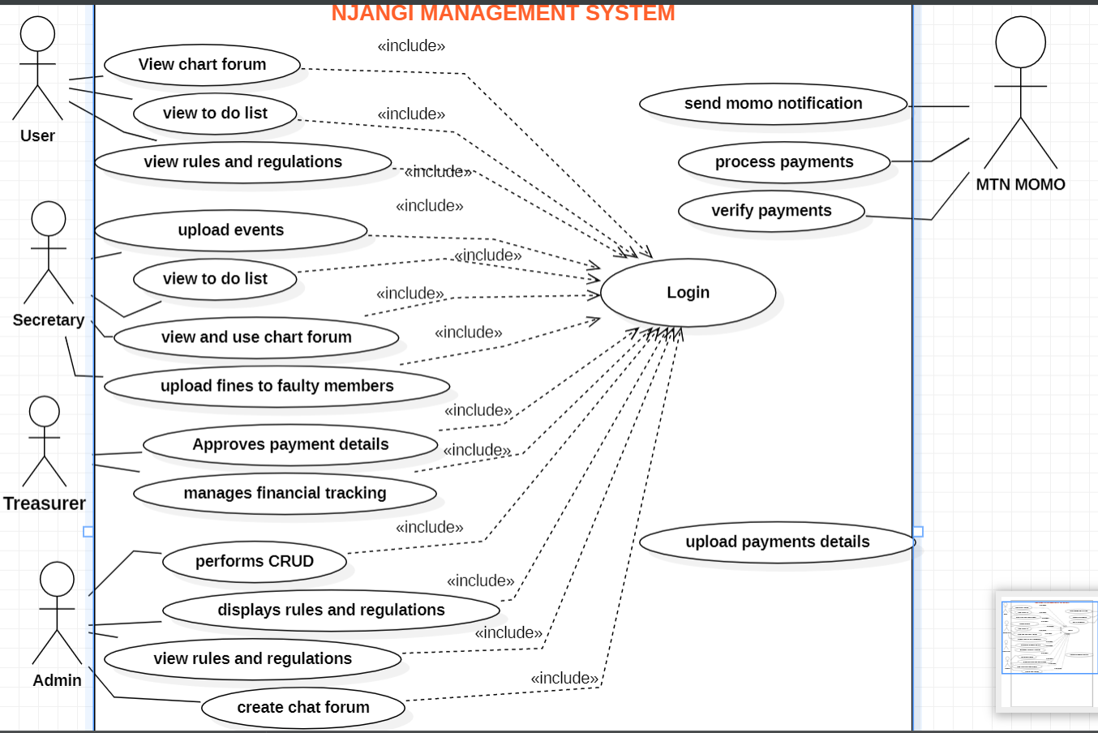
USE CASE DIAGRAM REPRESENATION

Slide 20
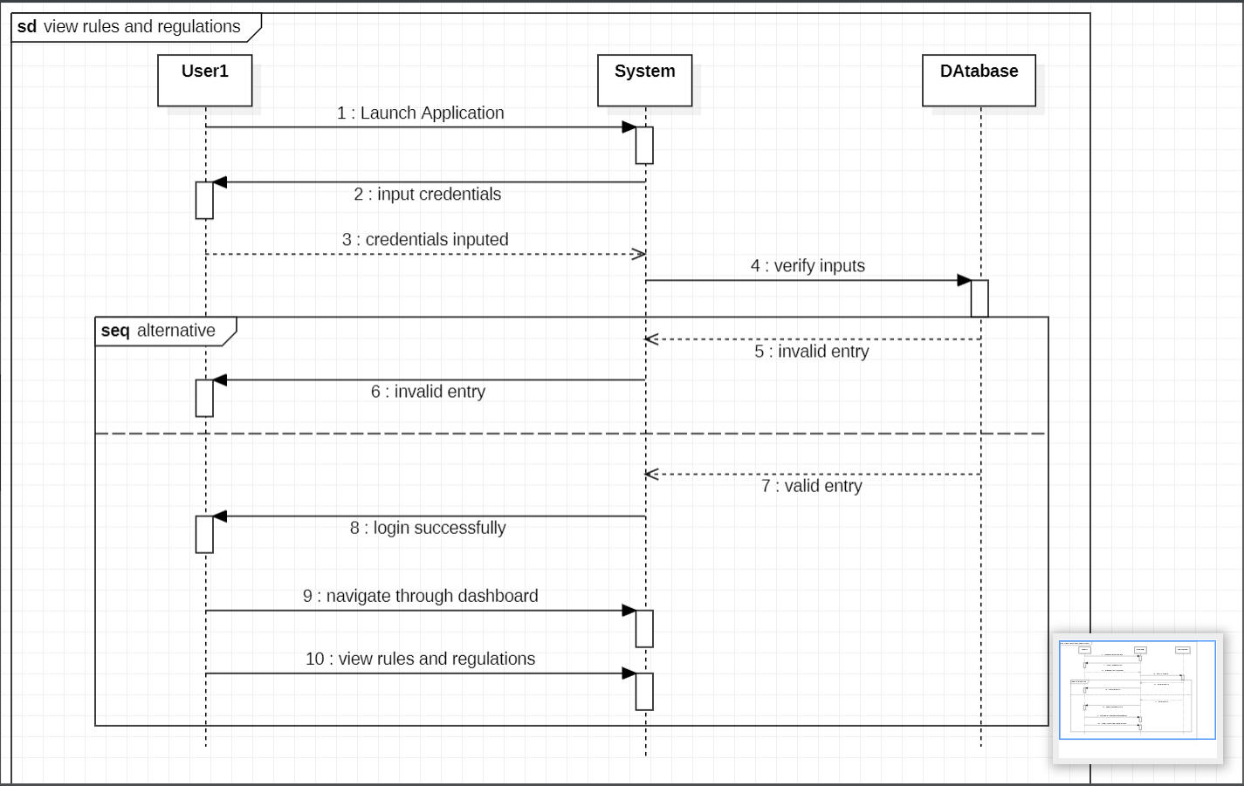
SEQUENCE DIAGRAM showing THE RULES AND REGULATIONS

Slide 21
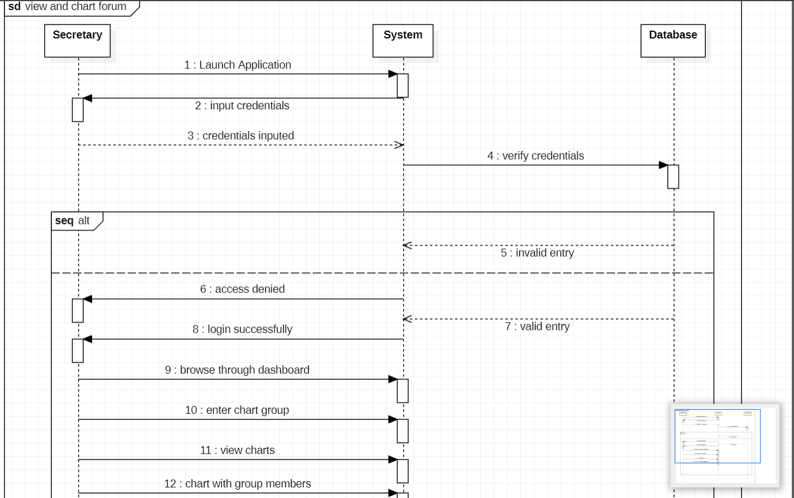
SEQUENCE DIAGRAM for SECRETARY CHARTING WITH GROUP MEEMBERS

Slide 22
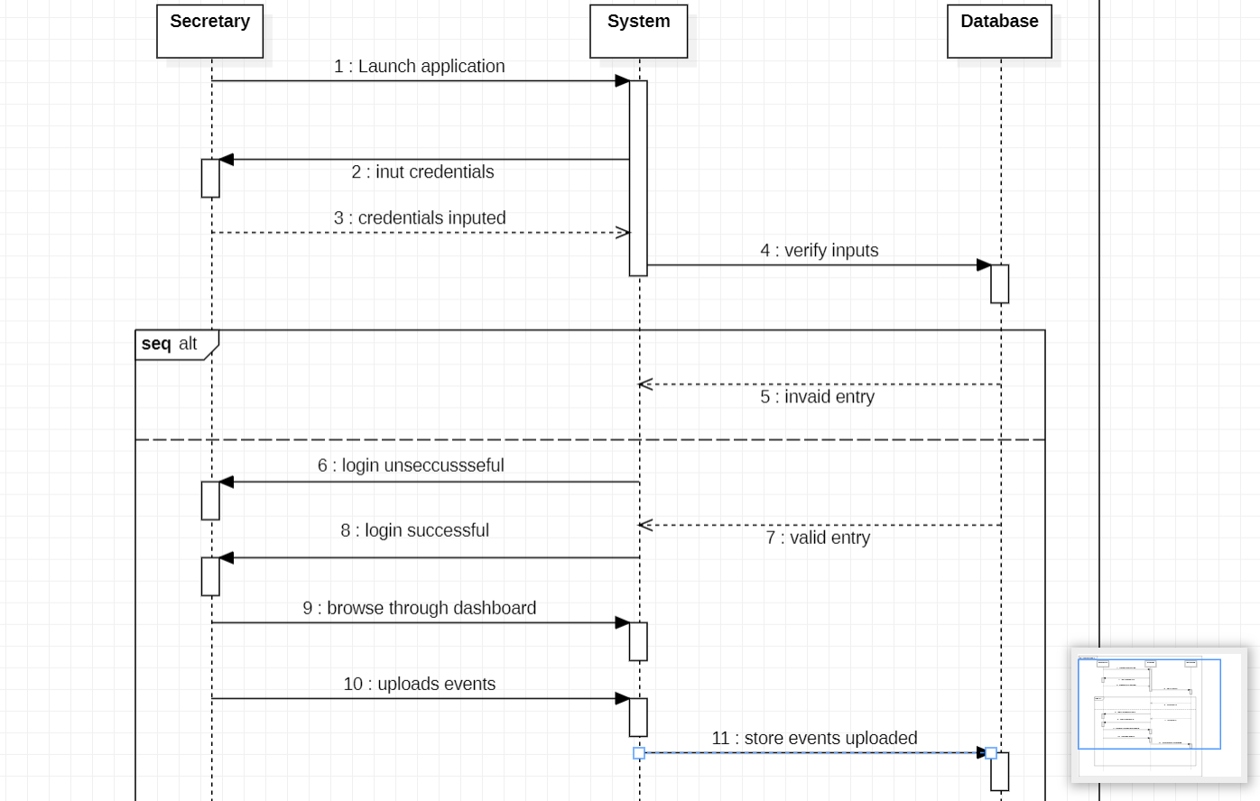
SEQUENCE DIAGRAM showing SECRETARY UPLOADING EVENTS

Slide 23
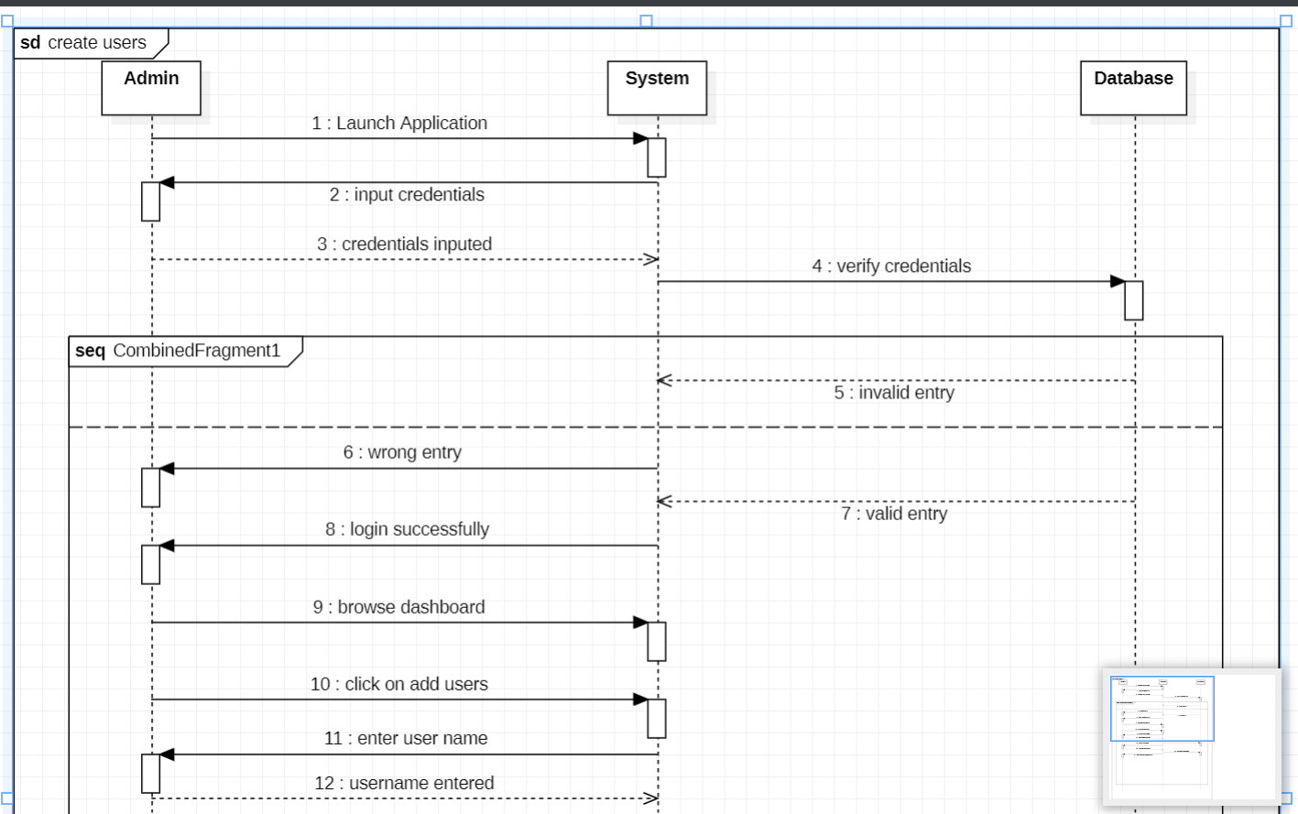
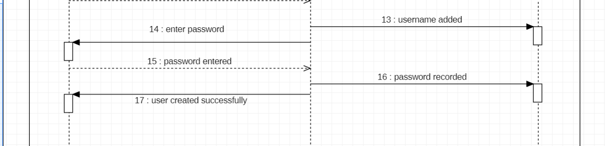

Slide 24
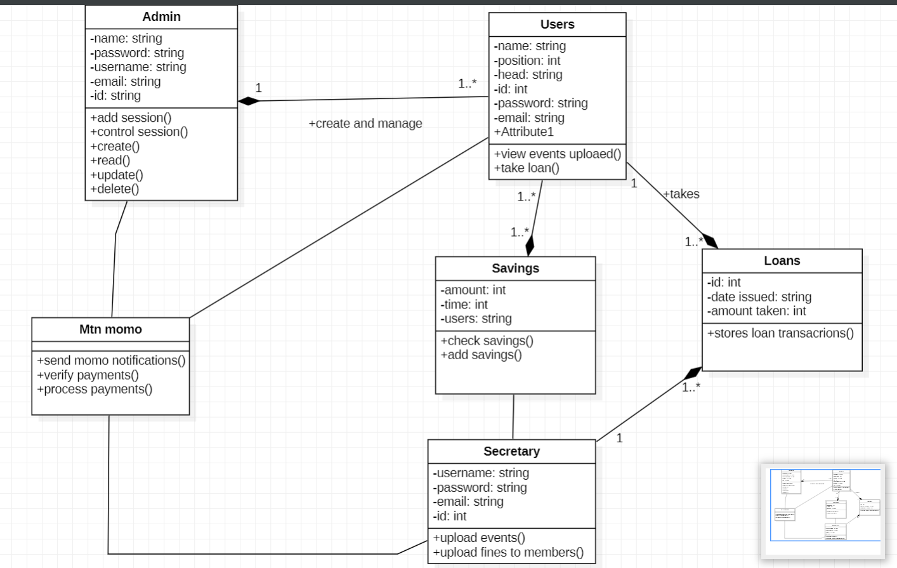
CLASS DIAGRAM REPRSENTATION FOR A NJANGI MANAGEMENT APPLICATION

Slide 25
BUSINESS OPPORTUNITIES
COMMUNITY BUILDING AND NETWORKING
You can establish an online community or forum where njangi participants can exchange ideas and share success stories and seek advice , monetization can be achieved through advertising, sponsored content or premium membership options
CONSULTING AND TRAINING
Providing consulting services on njangi management best practices, legal compliance, and financial literacy can be a viable business opportunities

Slide 26
SECURITY AND DATA PROTECTION
A business focusing on providing robust security measures, encryption and data protection services can find significant demand in this field .

Slide 27

Thank you
chunkebless27@gmail.com

